Slide 1
NLP — RNN PROJECT
AI-574 Spring II 2026
Professor Srinivasan
Pennsylvania State University
School of Graduate and Professional Studies
Group Discussion 3
Team 2
Aryaman Dev
Darren Greway
Saakshaat Saini
Zheng Tang
Tatoeba Language
Detection
Exploratory Data Analysis
10 Languages · 99,863 Train · 10,000 Dev · 178 Unique Characters
Tatoeba Project · Character-Level Analysis · Statistical & Visual Methods

Slide 2
AGENDA
What We Cover
Dataset Overview
Language Distribution
Sentence Length Analysis
01
02
03
Sizes, 10 languages, format, class balance
Train (99,863) vs Dev (10,000) counts
Box plot & histogram of char lengths
Character N-gram Fingerprinting
Language Similarity Heatmap
t-SNE Visualization
04
05
06
Top bigrams per language — train set
Cosine similarity of N-gram vectors
2D cluster separation — train & dev
Character Entropy
Exclusive Characters & Unicode
Baseline: Logistic Regression
07
08
09
Average entropy per language (2.54–2.69 bits)
Language-unique chars & script block analysis
99.30% accuracy + confusion matrix

Slide 3
DATASET OVERVIEW
Tatoeba Project — 10 Languages
99,863
10,000
10
178
Training Sentences
Dev Sentences
Languages
Unique Characters
⚠ Portuguese (por) has only 9,863 training sentences vs 10,000 for all other 9 languages — slight imbalance in train set only.
Languages in the Dataset
BER
DEU
ENG
EPO
FRA
Berber
German
English
Esperanto
French
HUN
ITA
POR
SPA
TUR
Hungarian
Italian
Portuguese
Spanish
Turkish
TSV format · No header row · Columns: [lang_code] [text] · 95th pct length: ~74 chars (train) / ~75 chars (dev)
Balanced for evaluation: Dev set: exactly 1,000 per language. Accuracy is a fair metric.
Character vocabulary: 178: All scripts combined: Latin, Tifinagh, Cyrillic variants.
RNN sequence length: ~74–100: 95th percentile at 74 chars guides max input length.
Portuguese train imbalance: -137: Only affects train set. Dev set remains perfectly balanced.

Slide 4
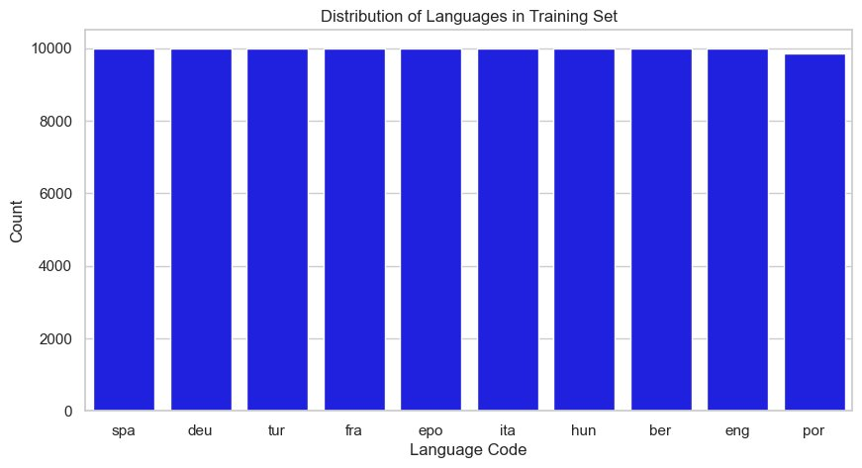
LANGUAGE DISTRIBUTION
Train: Nearly Balanced (por=9,863) · Dev: Perfectly Balanced (1,000 each)
Key Findings
9 × 10,000 sentences
All languages except Portuguese have exactly 10,000 training sentences.
por = 9,863 (train only)
137 fewer sentences. Dev set is perfectly balanced at 1,000 each.
Balanced → fair metric
Class balance means accuracy on the dev set is fully unbiased.
95th pct: ~74 chars
Sets the recommended max sequence length for RNN input.
Note: Dev set distribution identical — all 10 languages exactly 1,000 sentences.

Slide 5
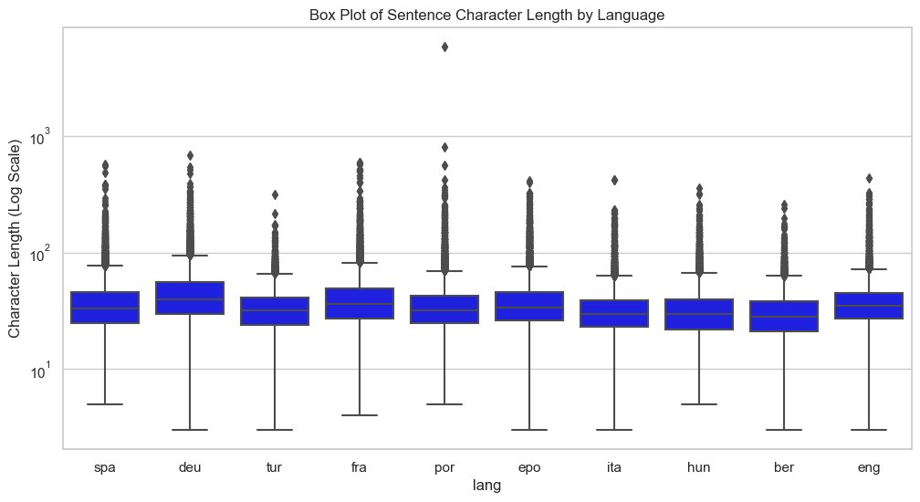
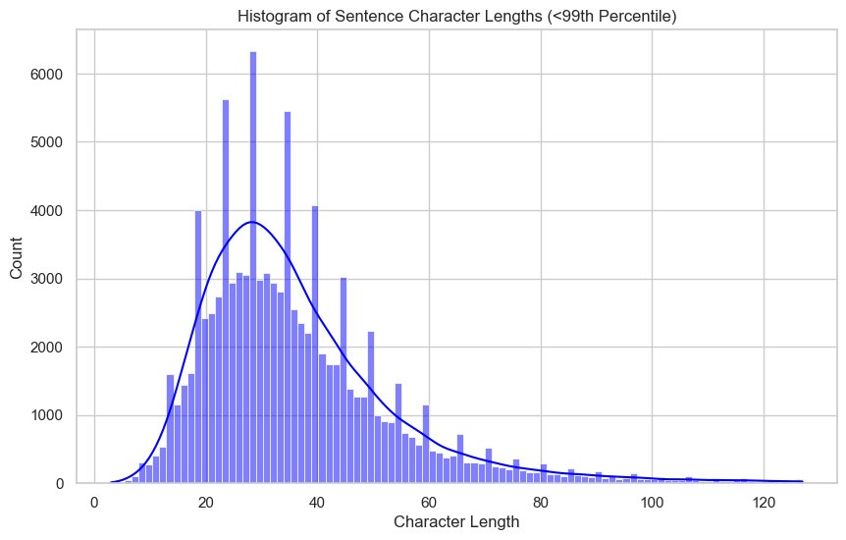
SENTENCE LENGTH ANALYSIS
Box Plot (Log Scale) & Histogram of Character Lengths
Train Set Statistics (exact values from notebook)
Language | Mean Chars | Median | Std Dev | Max Chars | Mean Words
ber | 30.9 | 28 | 15.0 | 257 | 4.98
deu | 48.1 | 40 | 32.7 | 690 | 8.00
eng | 38.5 | 35 | 20.8 | 437 | 7.60
epo | 40.0 | 34 | 26.1 | 412 | 7.05
fra | 42.3 | 36 | 30.6 | 597 | 7.69
hun | 33.8 | 30 | 19.7 | 361 | 5.26
ita | 33.3 | 30 | 18.0 | 425 | 5.84
por | 38.1 | 32 | 63.5 ⚠ | 5,833 ⚠ | 6.98
spa | 38.6 | 33 | 25.0 | 576 | 7.01
tur | 34.5 | 32 | 15.1 | 313 | 4.99

Slide 6
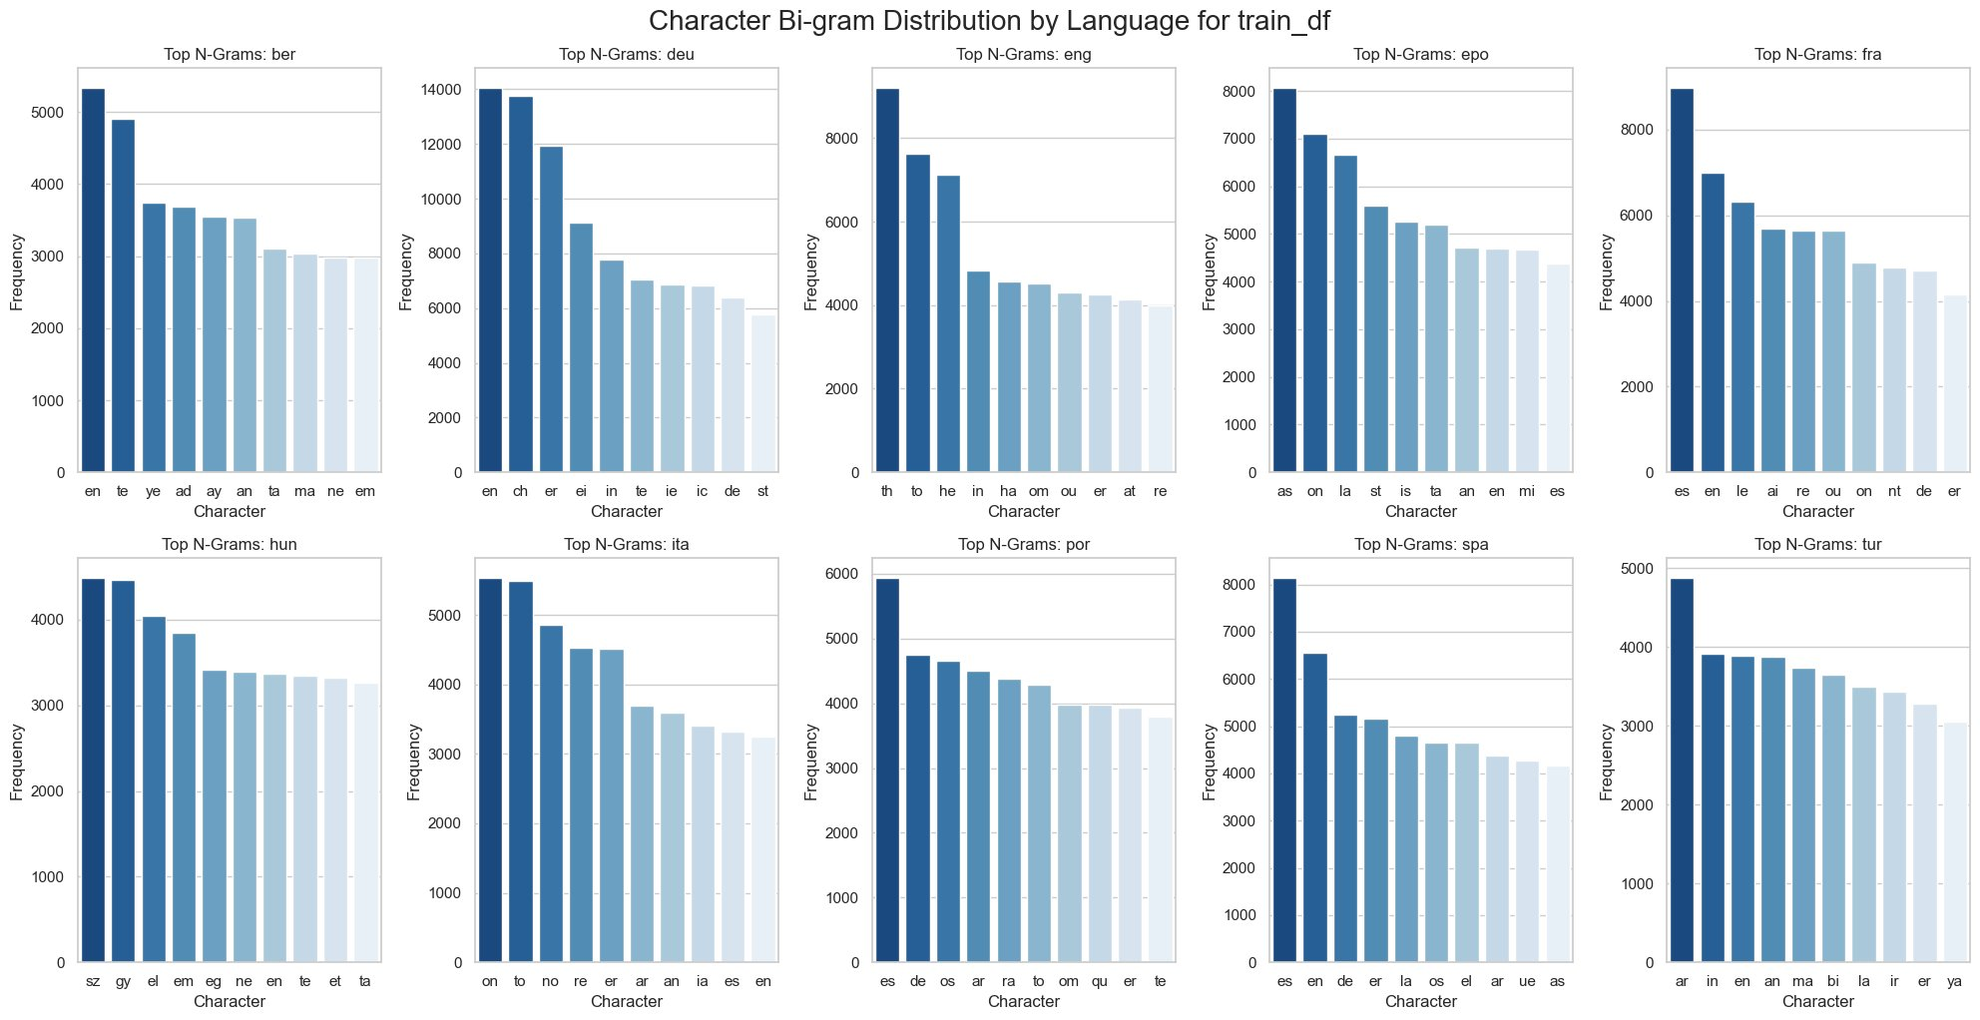
CHARACTER N-GRAM FINGERPRINTING
Top Bigrams per Language — Train Set

Slide 7
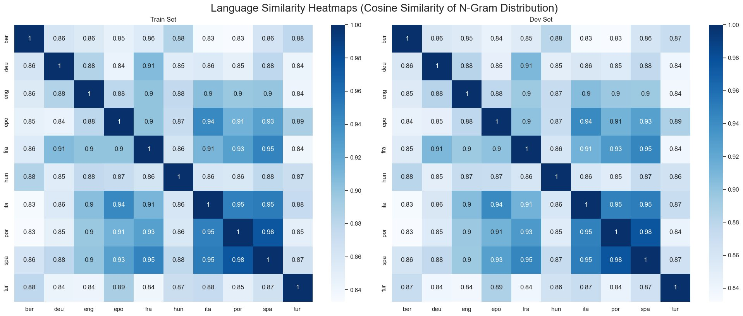
LANGUAGE SIMILARITY HEATMAP
Cosine Similarity of Character N-gram Vectors (1–3 grams)
Left: Train Set · Right: Dev Set · Values are consistent across both splits
Key: spa–por=0.98 & ita–por/spa=0.95 are the highest-similarity pairs (Romance confusion zone). ber is the most distinct language across all pairs. All Latin-script languages share ≥0.83 similarity — sequential RNN context is essential to separate them.

Slide 8
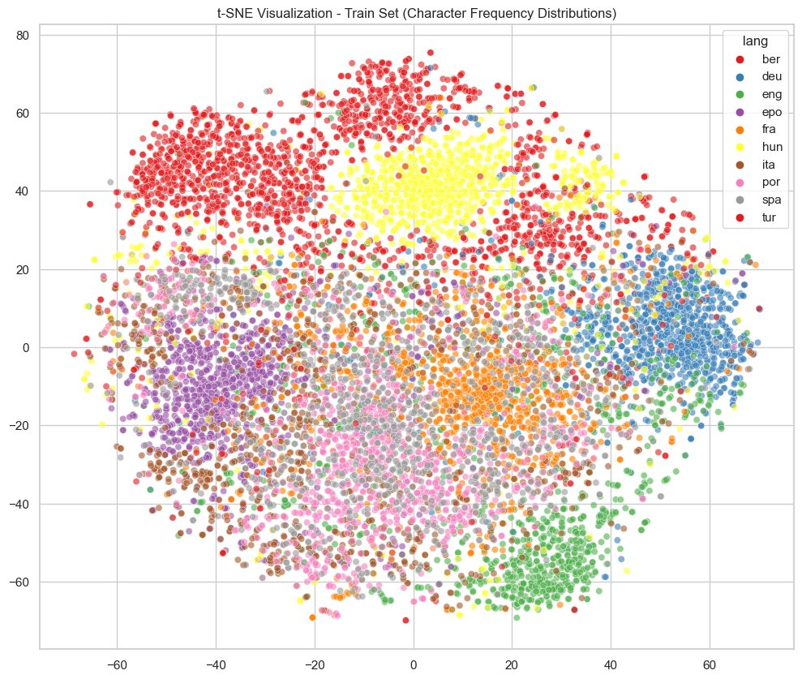
t-SNE VISUALIZATION — TRAIN SET
2D Language Clusters · 1,000 Sentences per Language · Perplexity=30
Observation: ber (red/top) and hun (yellow) form well-separated clusters. deu (blue) isolates on the right. The centre shows heavy overlap of Romance languages (spa/por/ita/fra) and epo — sequence-level context is needed to separate them.

Slide 9
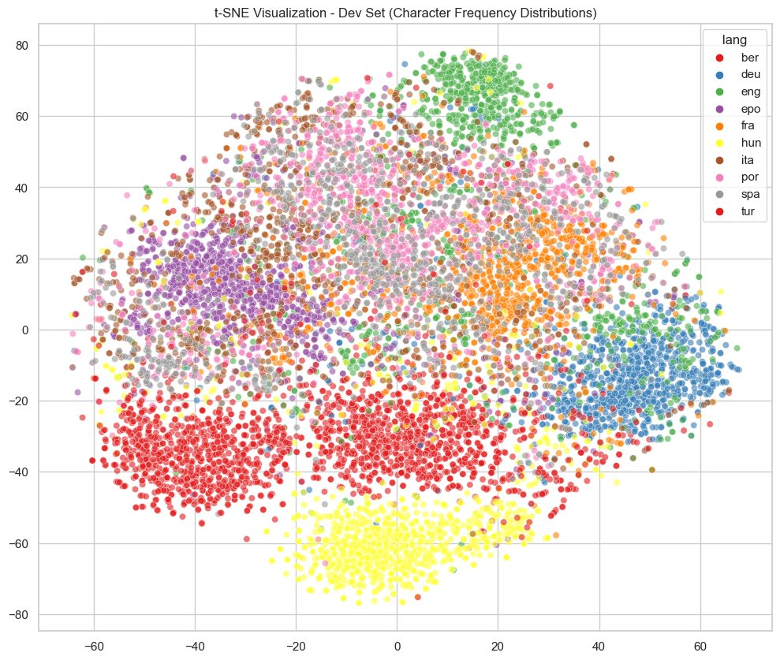
t-SNE VISUALIZATION — DEV SET
2D Language Clusters · 1,000 Sentences per Language · Perplexity=30
Observation: Dev cluster structure mirrors the train set — confirming dataset consistency. tur (red/bottom) is well-separated. eng (green) and deu (blue) cluster distinctly on the right. Romance languages remain interleaved in the centre.

Slide 10
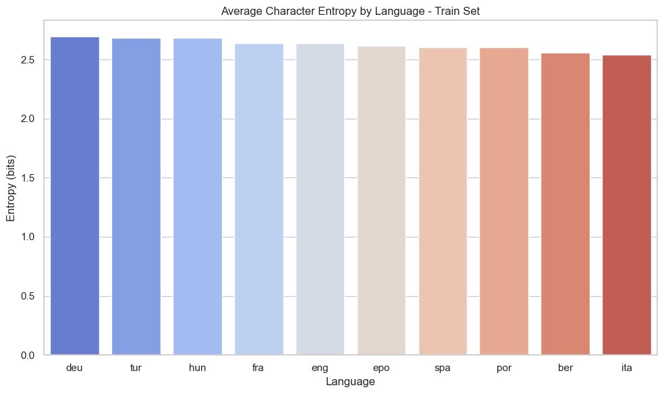

CHARACTER ENTROPY
Average Character Entropy per Language — Range: 2.54 to 2.69 bits
Train Set
Dev Set
Narrow range: 2.54–2.69 bits: Entropy alone is NOT a reliable discriminator — differences are tiny across all 10 languages.
deu, tur, hun rank highest: More diverse character usage — wider unique character sets and more varied text structures.
ber, ita rank lowest: Consistent character patterns. Consistent with their Romance/Berber frequency profiles.
Train ≈ Dev distributions: Nearly identical ordering — confirms the train set is representative of the dev set.

Slide 11
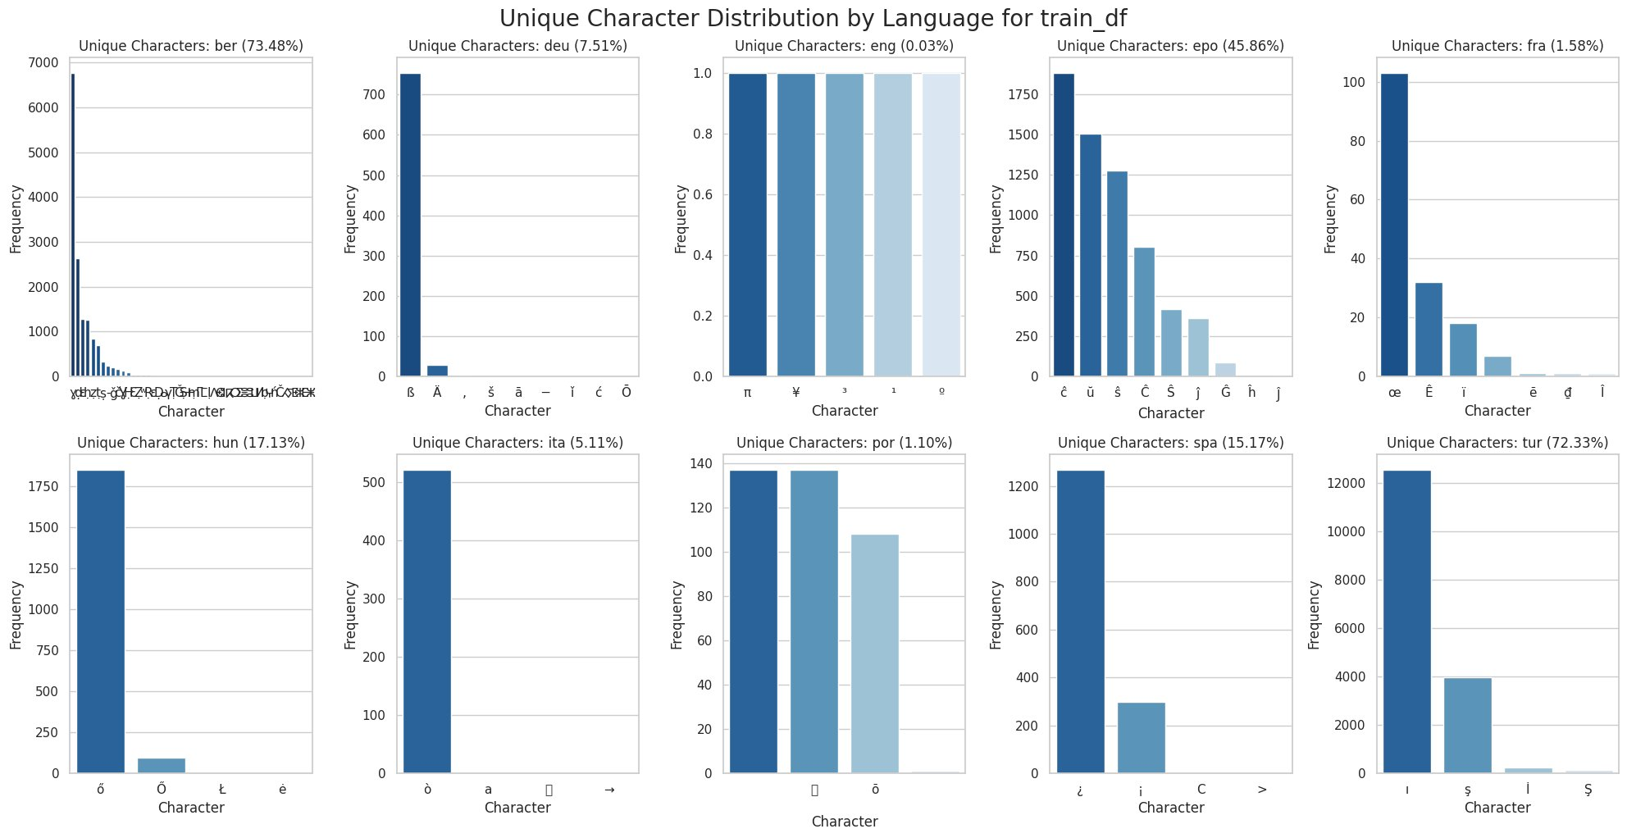
UNIQUE CHARACTERS
Language-Exclusive Character Frequency (Train Set)
% texts with ≥1 unique char: ber=73.5% tur=72.3% epo=45.9% hun=17.1% spa=15.2% deu=7.5% ita=5.1% fra=1.6% por=1.1% eng=0.03%

Slide 12
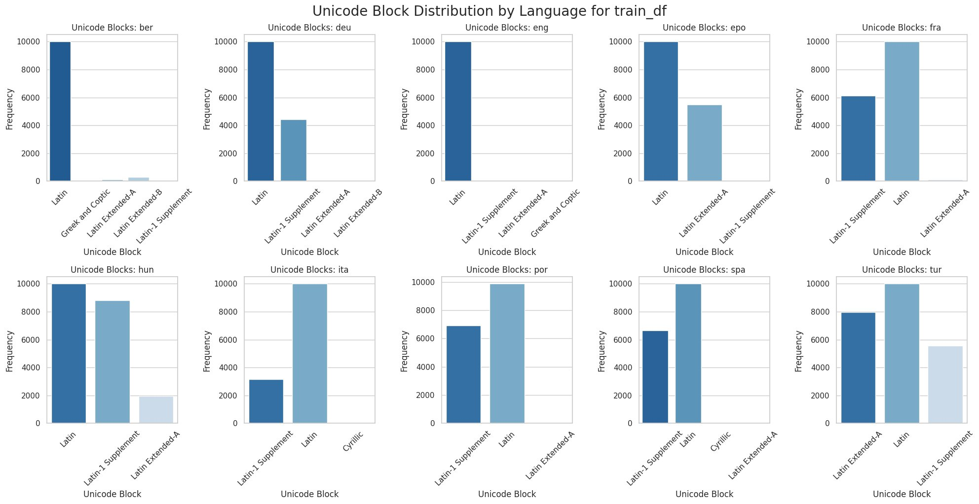
UNICODE BLOCK DISTRIBUTION
Script Block Analysis per Language (Train Set)
Key: ber uses Greek/Coptic + Latin Extended (Tifinagh). deu/eng/epo/fra/hun: Latin + Latin-1. ita/por/spa: Latin-1 Supplement dominant. tur: unique Latin Extended-A (ş, ğ, ı). Script block alone can only cleanly isolate ber.

Slide 13
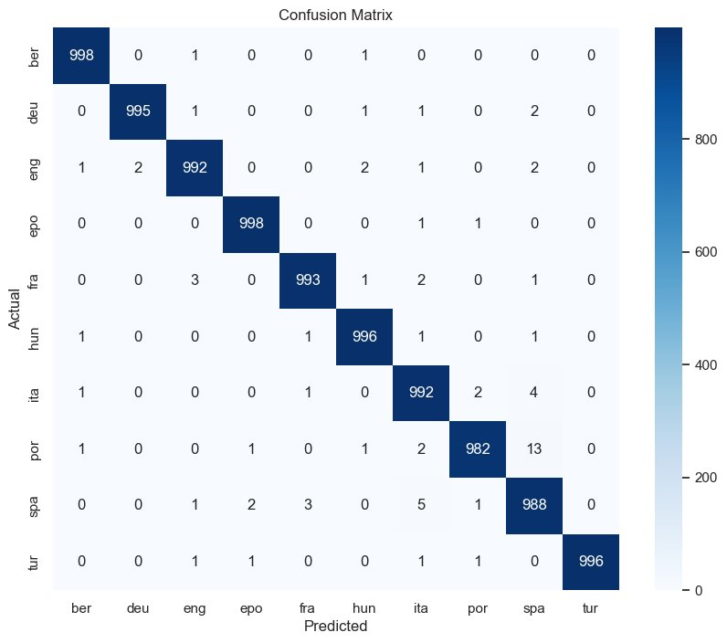
BASELINE MODEL
Logistic Regression on Char N-grams (1–3) · Dev Accuracy: 99.30%
Classification Report (Dev Set)
Language | Prec | Recall | F1
ber | 1.00 | 1.00 | 1.00
deu | 1.00 | 0.99 | 1.00
eng | 0.99 | 0.99 | 0.99
epo | 1.00 | 1.00 | 1.00
fra | 0.99 | 0.99 | 0.99
hun | 0.99 | 1.00 | 1.00
ita | 0.99 | 0.99 | 0.99
por | 0.99 | 0.98 | 0.99
spa | 0.98 | 0.99 | 0.98
tur | 1.00 | 1.00 | 1.00
ber, epo, tur — perfect 1.00 F1: Unique scripts/diacritics make these trivially classifiable.
por: 13 errors → predicted as spa: Highest confusion pair. Similarity = 0.98.
ita: 4→spa, 2→por — Romance triple: spa/por/ita account for almost the entire error budget.
Config: CountVectorizer(char, 1–3 grams) + LogisticRegression(max_iter=1000)

Slide 14
CONCLUSIONS
Key EDA Takeaways &
RNN Design Implications
1
ber (73.5%) & tur (72.3%) trivially classifiable via unique characters:
Tifinagh script and Turkish diacritics (ı, ş, İ) act as immediate class signals — no sequence model needed for these two.
2
spa–por similarity = 0.98 — the core classification challenge:
Only 13 mutual errors from logistic regression. The RNN must exploit sequential patterns to push this lower.
3
Baseline: 99.30% exact dev accuracy (char 1–3 grams + LogReg):
The performance bar. RNN target: match or exceed, specifically improving the Romance language confusion.
4
Entropy range 2.54–2.69 bits — nearly uniform across all languages:
Frequency features have limited power for similar languages. Sequence context matters more than character counts.
5
Architecture: char embeddings + RNN, vocab=178, seq length ~74–100 chars:
Character-level input captures script and bigram signals. 95th pct at 74 chars sets the practical input length.

